Slide 1
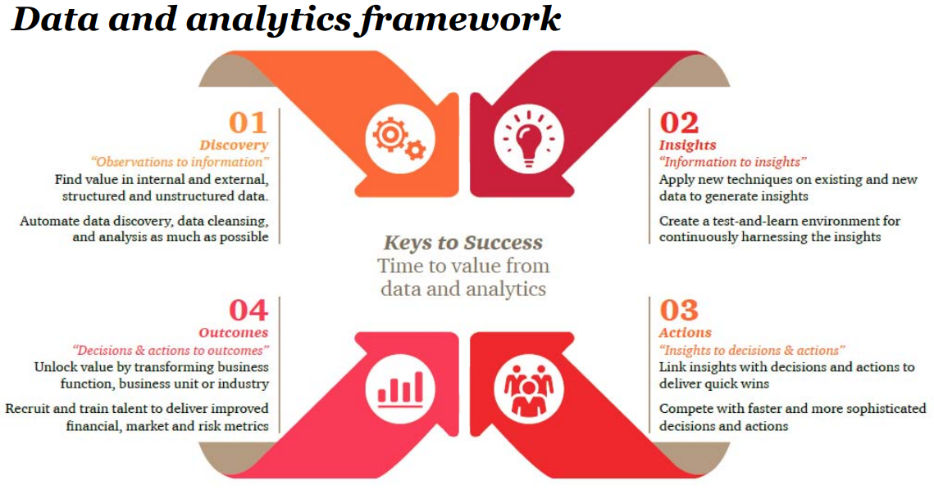
Formulating Business Intelligence (BI) Questions
BI questions are used to probe into data, leading to insights that drive strategic business decisions.
For example, in the context of the Assignment, the BI question you formulate will determine which data you will need and ensure that the analytics technique you choose aligns with your BI question and produce the intended insights.
To formulate your BI question – it is important to have a step-by-step plan or a framework.
In the following slides, you will be introduced to the Data and Analytics Framework and how you can apply this step-by-step to select the right data and data analytics technique, the right visualizations etc.
Source, PwC, 2024

Slide 2
Applying the Framework to Formulate the Right BI Question & Align Data with Intended Outcomes
Tip! Start with the Outcomes (Stage 4) then work your way up
Stage 4 Outcomes (start with end in mind)
Start by defining the desired business outcome (intended Business Outcome).
In this case, We want to improve bicycle sales long term
This broad objective can lead to multiple BI Questions related to different factors affecting bicycle sales.

Slide 3
Stage 1 Discovery: Formulate BI Questions and Procure Data
Begin with formulating BI questions that can lead to the intended outcome.
This stage is initially about data exploration
Use the example BI question to guide your discovery What is the relationship between the weather and sales?
Considering the provided datasets—InventorySystem.xlsx, Sales-database.xlsx, and viewEmployee.xlsx—determine additional data needed to support your BI question.
Here are some examples
Weather data, may include temperatures, precipitation levels, weather events sunshine duration
External variables such as holidays or economic indicators (eg GDP)

Slide 4
Stage 2A Insights: Gain Insights Through Analysis
During this stage we decide on appropriate analytical techniques to gain insights.
For instance, using Power BI you could perform analysis to explore the relationship between weather patterns and sales.
Example Insight -analysis in Power BI might reveal that bicycle sales dip in colder climates.
Note/ for this Assignment, you are not required to perform analysis or provide any visualizations. This is for illustration purpose.

Slide 5
Stage 2B Insights: Apply Visualizations to Enhance Insights
Select Power BI visualizations that effectively present your findings, such as heat maps correlating product sales with temperature fluctuations.
Use Power BI's "Top N" feature to focus on cities with the highest temperatures and correlate this with bicycle sales data.
Insight example - discovering that the top 10 hottest cities have the highest bicycle sales.
Note/ for this Assignment, you are not required to perform analysis or provide any visualizations. This is for illustration purpose.
Notes:
Another example, For example, our previous insight that Bicycles are not selling well in colder weather might lead us to investigating
whether there is a relationship between the weather pattern and sales
To do so consider correlation analysis (Advanced Analytics)
In Power BI scatter plots can be used to examine the relationship between sales and different weather metrics

Slide 6
Stage 3 Actions (Business Decisions): Recommend Actions Based on Findings
Insight example from the previous slide - discovering that the top 10 hottest cities have the highest bicycle sales.
Based on this insight make recommendations for business decisions based on your insights.
Recommend.
This insight can lead to actionable business strategies such as, the organization needs to intensifying marketing efforts in warmer cities to capitalize on higher sales potential.
Assignment 2 Tip – See Section

